Slide 1

Inferring groundwater recharge using remotely-sensed land surface temperature in the Phoenix metropolitan area
S. Khalid and E. R. Vivoni
Arizona State University
Identifying groundwater recharge areas in urban and non-urban environments is challenging. Our project is aimed at identifying potential recharge sites based on the strong relationship between land surface temperature (LST) and the presence of water.

Slide 2
ADWR-Locations of incidental recharge,2009

Slide 3
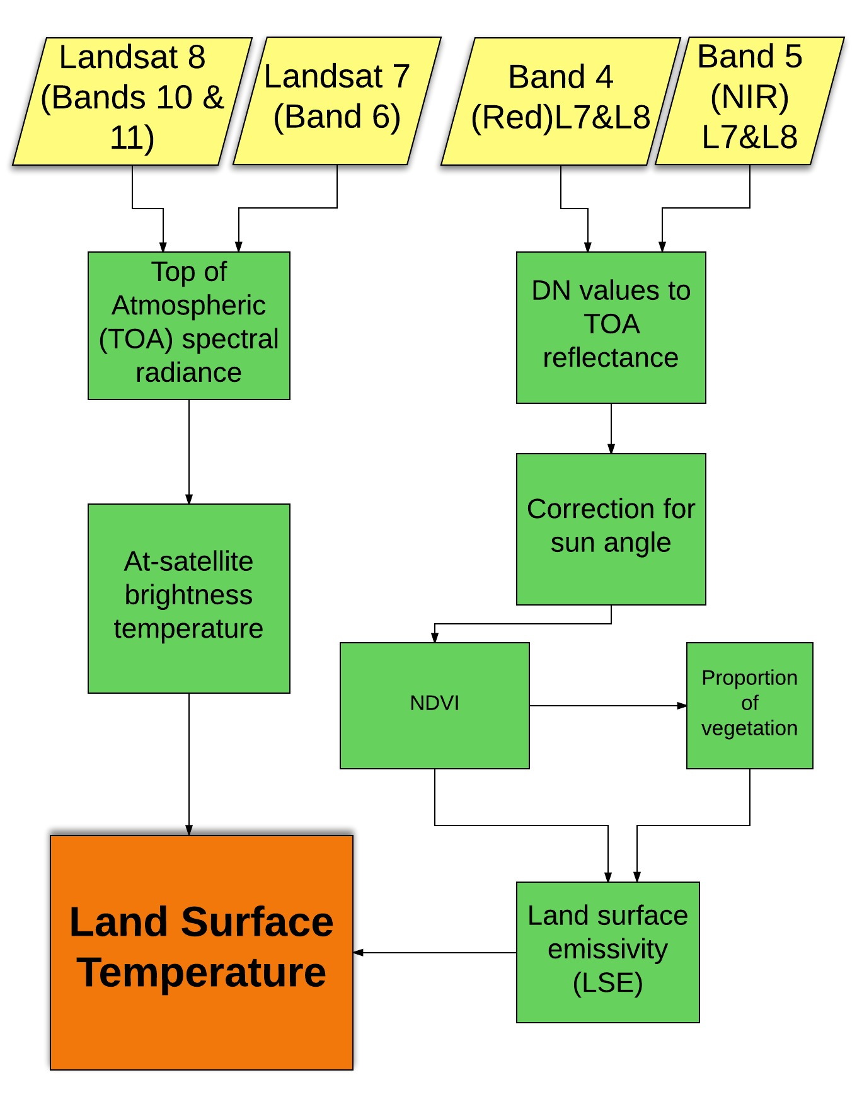

Methods
1- Remotely-sensed data
NDVI (Normalized Difference Vegetation Index):
$$\frac{NIR−RED}{NIR+RED}$$

Slide 4
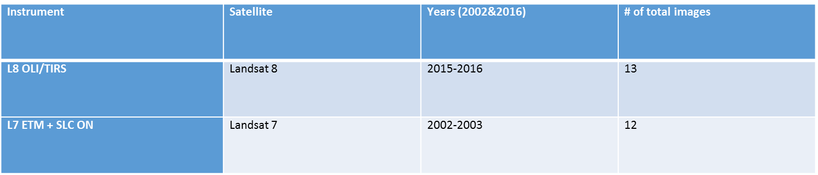
Res: 30 m | Band 3 (µm) | Band 4 (µm) | Band 5 (µm) | Band 6 (µm) | Band 10 (µm) | Band 11 (µm)
Landsat 7 | 0.63-0.69 (RED) | 0.77-0.90 (NIR) |  | 10.4-12.5
Landsat 8 |  | 0.64-0.67 (RED) | 0.85-0.88(NIR) |  | 10.6-11.19 | 11.5-12.51

Slide 5
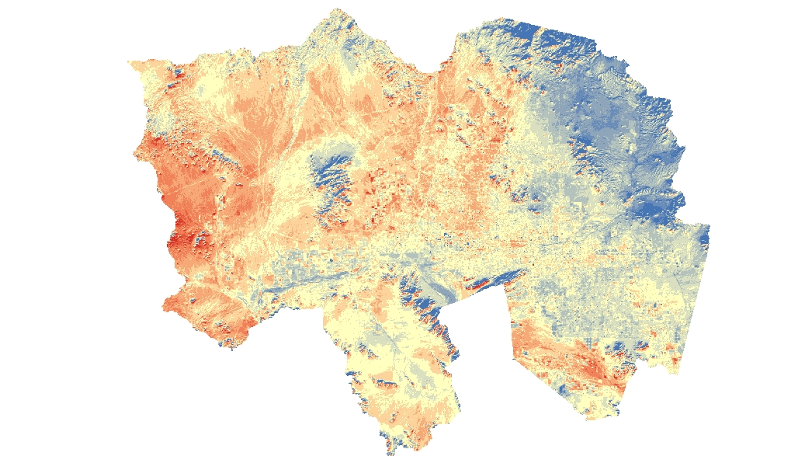
Processed Land Surface Temperature (LST) image, Dec 17, 2015

Slide 6
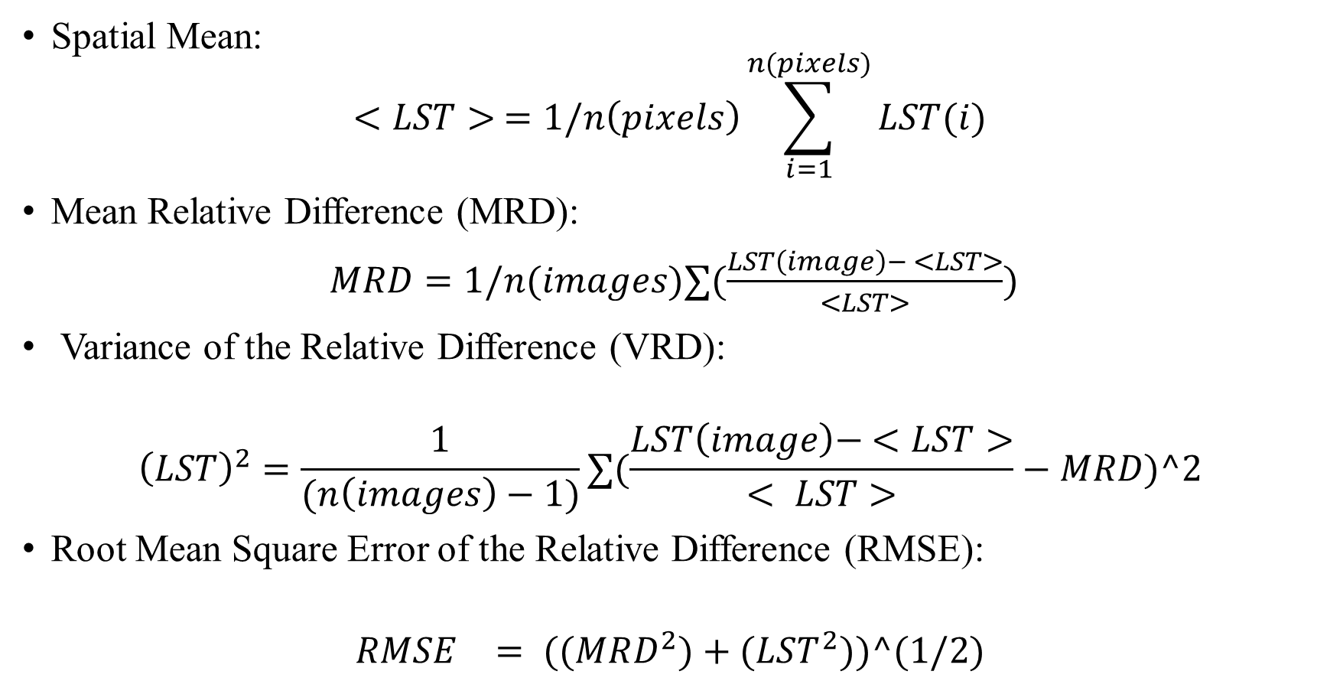
2- Analysis methods
Spatial Mean:
$$<LST> =1/n\left(pixels\right)\sum_{i=1}^{n(pixels)}{LST(i)}$$
Mean Relative Difference (MRD):
$MRD=1/n(images)∑(\frac{LST\left(image\right)− <LST>}{<LST>})$
Variance of the Relative Difference (VRD):
$${\left(LST\right)}^{2}=\frac{1}{(n\left(images\right)−1)}∑(\frac{LST\left(image\right)− <LST>}{< LST>}−MRD)^2$$
Root Mean Square Error of the Relative Difference (RMSE):
$${RMSE}^{}= ((MRD^{2})+(LST^{2}))^(1/2)$$

Slide 7
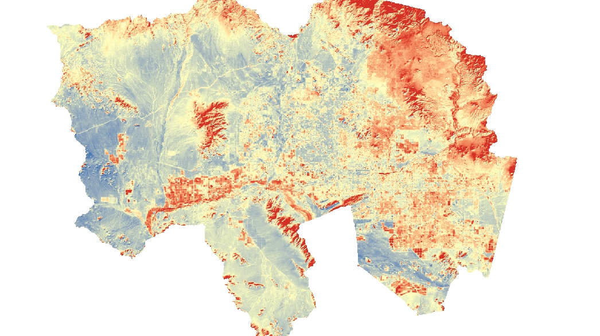
$$MRD=1/n(images)∑(\frac{LST\left(image\right)− <LST>}{<LST>})$$
Results

Slide 8
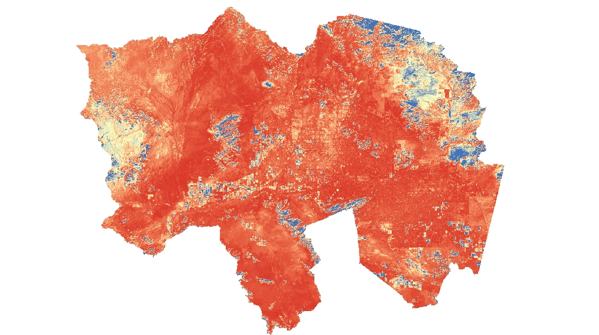

Variance of the Relative Difference (VRD):
$${\left(LST\right)}^{2}=\frac{1}{(n\left(images\right)−1)}∑(\frac{LST\left(image\right)− <LST>}{< LST>}−MRD)^2$$

Slide 9
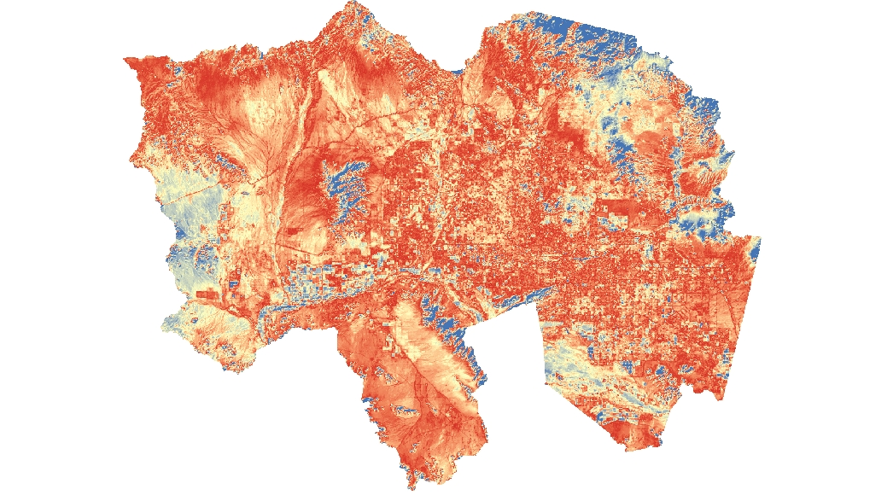
Root Mean Square Error of the Relative Difference (RMSE):
$${RMSE}^{}= ((MRD^{2})+(LST^{2}))^(1/2)$$

Slide 10
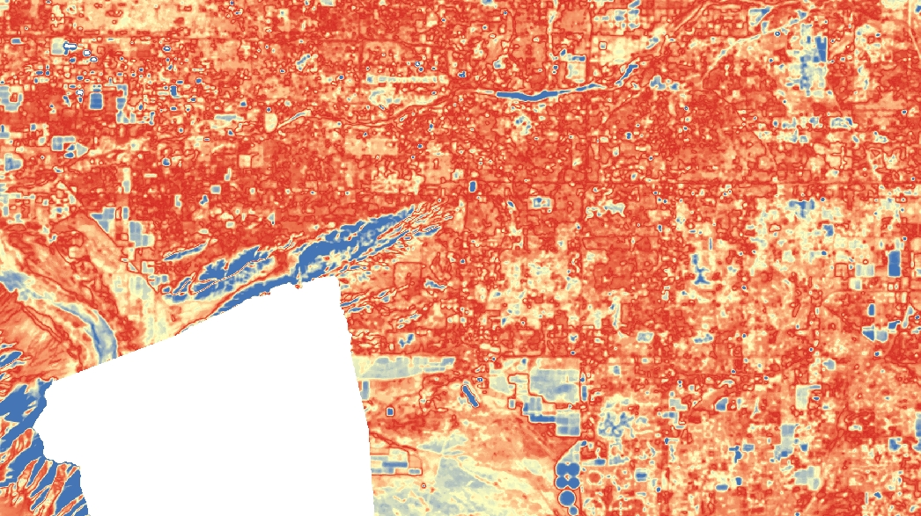
A closer look- Tempe Town Lake, RMSE (2015-2016)
RMSE:
Small values (red): time stable locations that always capture spatial average conditions
Large values (blue): sites that do not track spatial mean, their value also very different than spatial mean
Conclusion:
Red areas: low recharge potential
Blue areas: high recharge potential

Slide 11
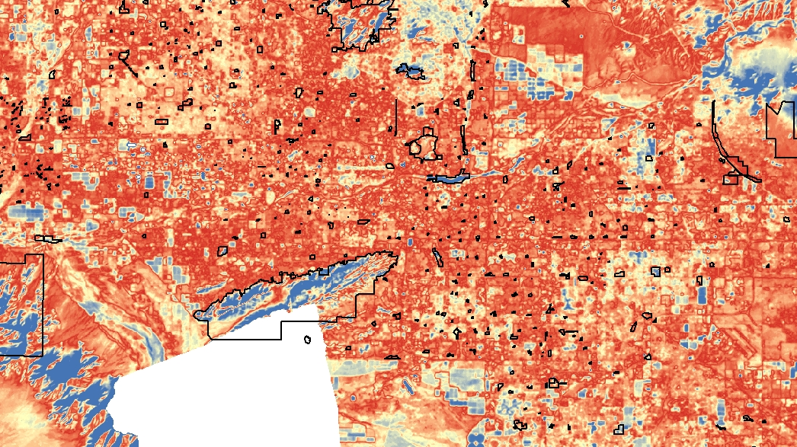
Conclusions: relationship to urban, natural and agricultural features

Slide 12
Acknowledgments:
Dr. Enrique Vivoni
NASA Space Grant (Dr. Thomas Sharp and Desiree Crawl)
Dr. Ted Bohn
David Nelson
Eli Perez
Questions??

